Slide 1
Procedural Mesh Generation
Christopher Eicher
Jason Murray
12/6/17

Slide 2

Procedural Mesh Generation
Fun pictures
Code Conventions
Math
Make Money!
Get bought out

Slide 3
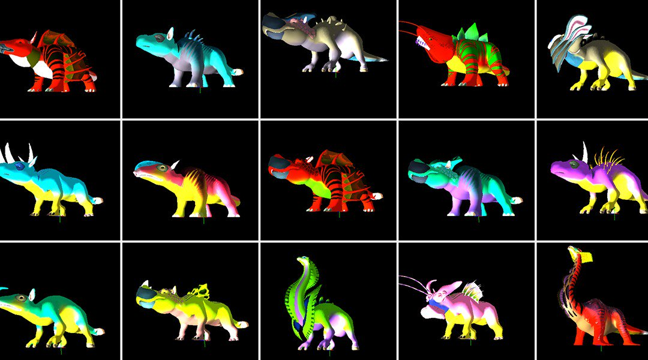
We are good at seeing patterns

Slide 4
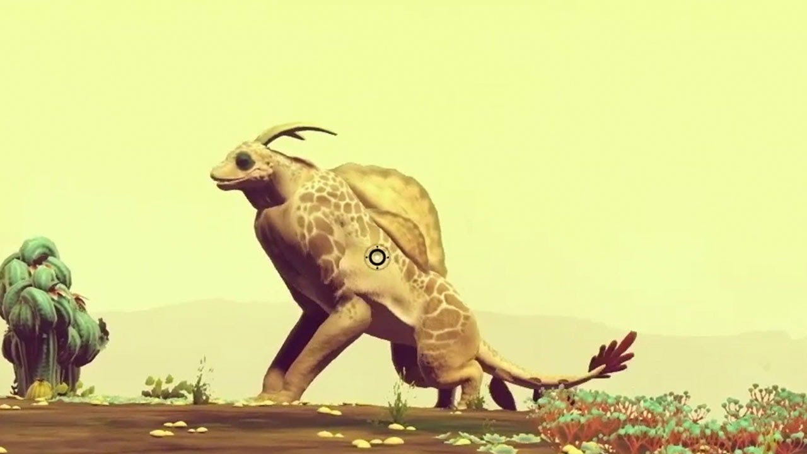
Lego block approach only gets you so far
Bricks are harder to make interesting
Notes:
We want to do more than make content that looks like mashed together parts

Slide 5
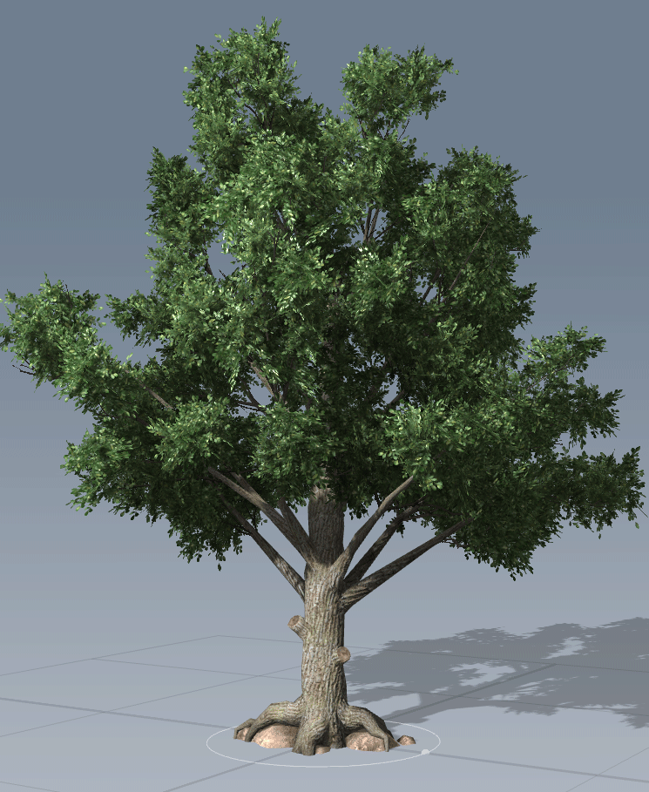
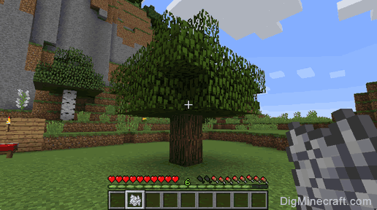
Procedural content generation ≠ blended copy-paste
We can do better
Notes:
We want to do more than make content that looks like mashed together parts

Slide 6
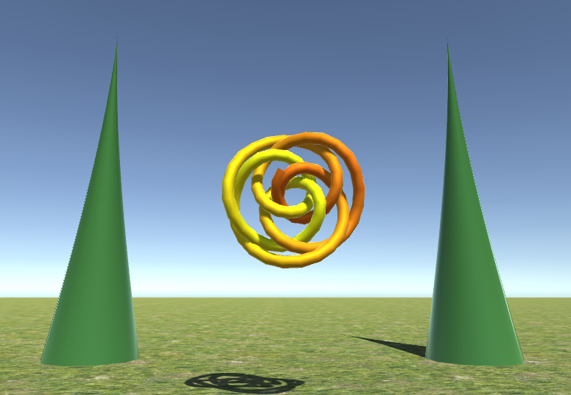
Why Procedural Mesh Generation?
Greater capacity for uniqueness

Slide 7
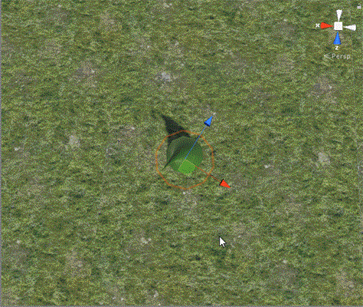
Why Procedural Mesh Generation?
Highly parameterized

Slide 8
Why Procedural Mesh Generation?
Only limited by algorithmic imagination
…as we’ll see later

Slide 9
We can assume some conventions
for (int i = 0; i < iterations; i++)
{
// [0,1] increasing
float t = (float)i / iterations;
// compliment of t, [0,1] decreasing
float tc = 1 - t;
}
Notes:
We want to do more than make content that looks like mashed together parts

Slide 10
Linear Transformation Refresher
vec3 pos = vec3(0, 0, 0);
vec3 dir = vec3(0, 1, 0);
vec3 scale = vec3(1, 1, 1);
/* Translate <- Rotate <- Scale */
mat4x4 trans =
Trans(pos) *
Quaternion.LookAt(dir, vec3(0, 1, 0)) *
Scale(scale);

Slide 11
Mesh Structure
std::vector<vec3> verts;
std::vector<int> faces;
std::vector<vec2> uvs;

Slide 12

Lets make rings!
void MakeRing(mat4x4 localToModel, int subdivisions, ...)
{
for (int i = 0; i < subdivisions; i++)
{
float r = t * 2 * PI; // radians
vec4 vert = vec4(cos(r), sin(r), 0, 1);
verts.push_back(localToModel * vert);
uvs.push_back(vec2(t, v));
}
}

Slide 13
Lets make loops
int topEdge = 100;
int bottomEdge = 200;
100 + 1
100
200 + 1
200

Slide 14
Lets make loops
int AddBand(int topEdge, int bottomEdge, int numVerts) {...}
topEdge + i + 1
topEdge + i
bottomEdge + i + 1
bottomEdge + i

Slide 15
Simple building blocks facilitate complex composition
Lattices
Bands

Slide 16
Simple building blocks facilitate complex composition
Bands

Slide 17
Demo

Slide 18
Questions/Comments

